Slide 1

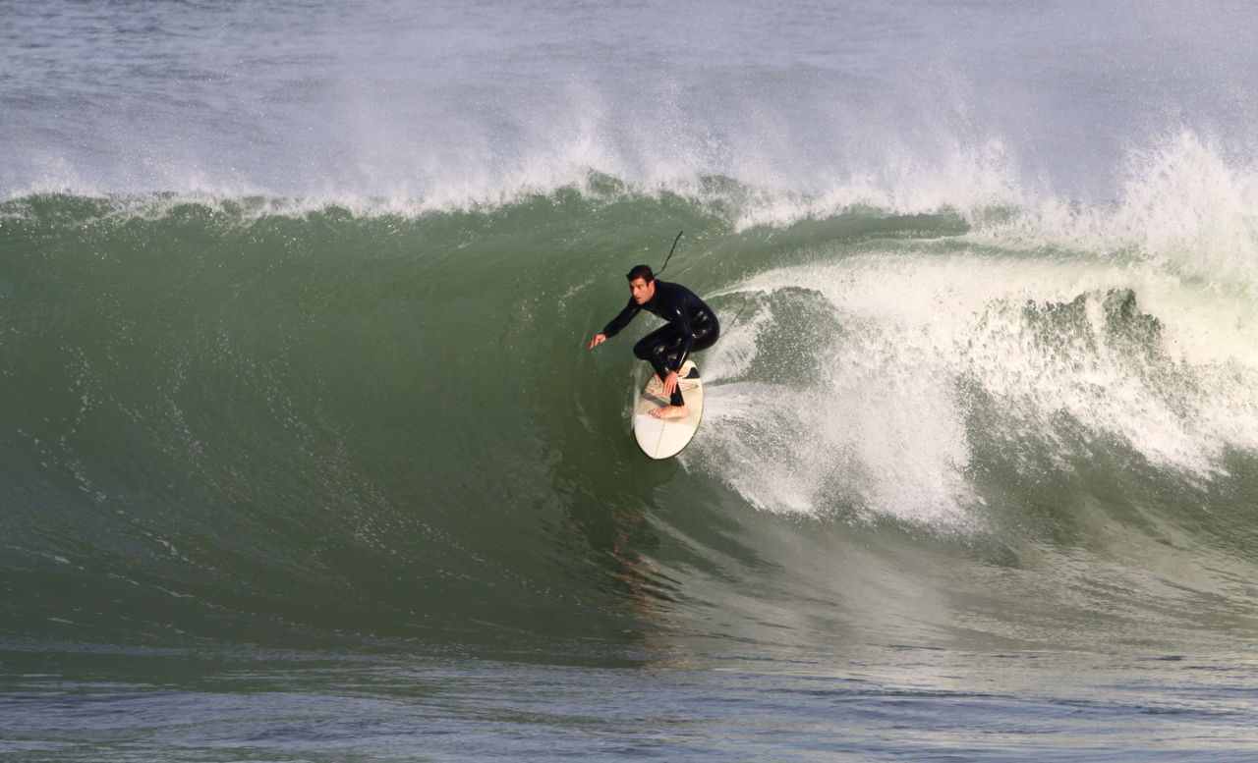
Life Universecity LC Retreat 2018
Welcome to WATER LIFE
"If there is magic on this planet, it is contained in Water"
– Loren Eiseley.
In one drop of water are found all the secrets of all the oceans; in one aspect of You are found all the aspects of existence. ― Khalil Gibran
Life in us is like the water in a river. ― Henry David Thoreau

Slide 2
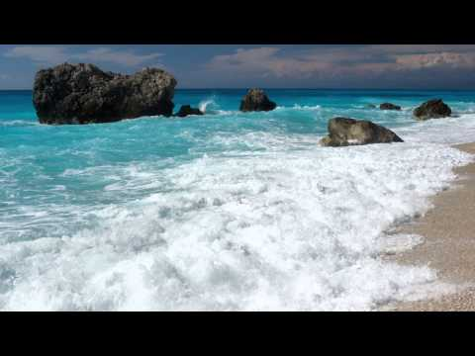
Life Universecity LC Retreat 2018
Meaning and Symbolism of Water. ... The symbolism of water has a universal undertone of purity and fertility. Symbolically, it is often viewed as the source of life itself.
Water Quotes: Water is the driving force of all nature – Leonardo Da Divinci. No water, No Life – by Sylvia Earle. When you do things from your soul, you feel a river moving inside you, a joy. - by Rumi
Exercise: Relax your body, Become very still, Close your eyes, Listen to the sea, hear the sound of the waves

